Slide 1
What’s API

Slide 2
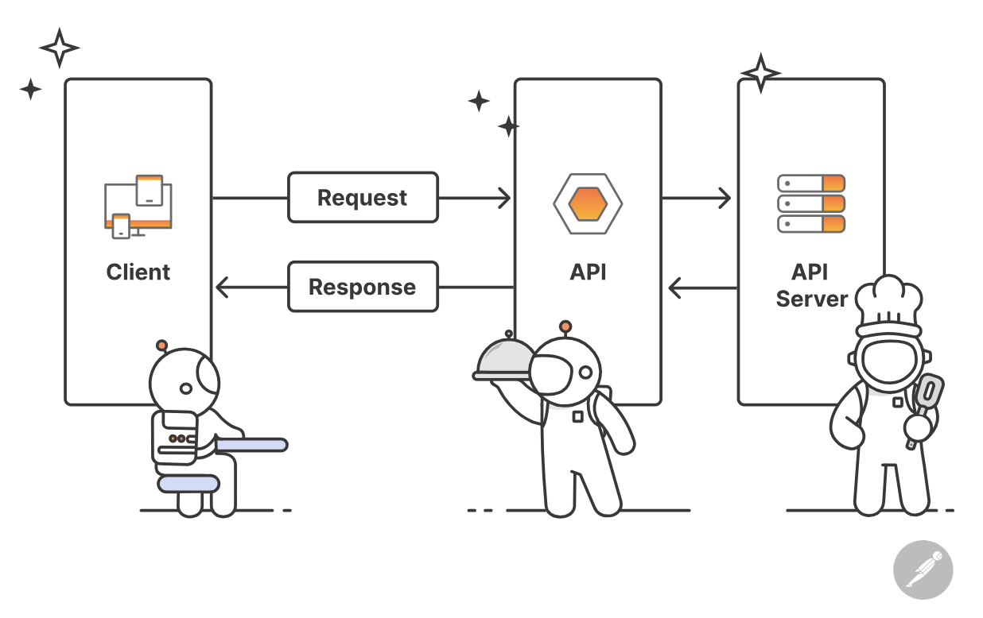
API
An API, which stands for application programming interface, is a set of protocols that enable different software components to communicate and transfer data.
Reference: https://www.postman.com/what-is-an-api/

Slide 3
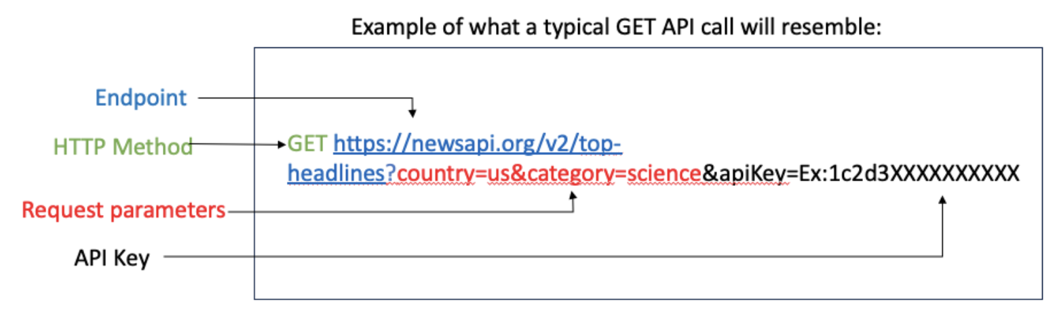
Key components
Http Method
Endpoint
Parameters
Header
Cookies
Body
Status Code
Reference: https://technologyadvice.com/blog/information-technology/how-to-use-an-api/

Slide 4
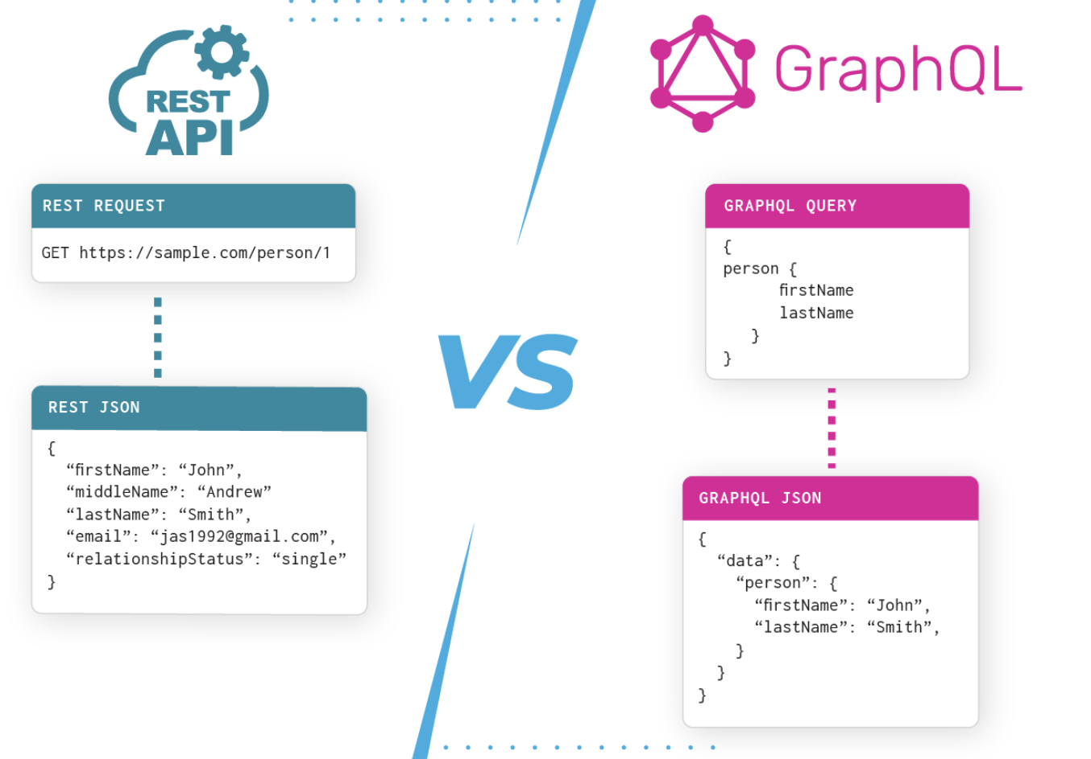
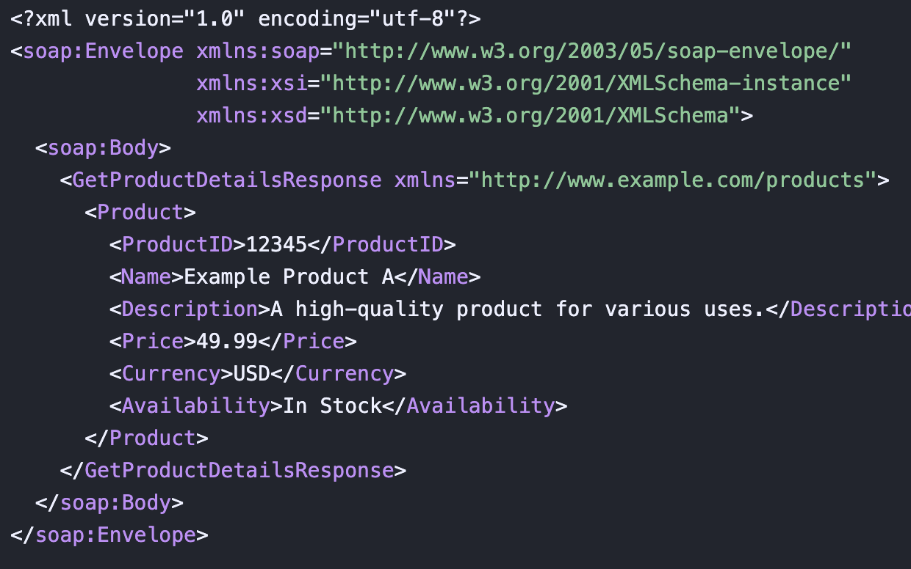
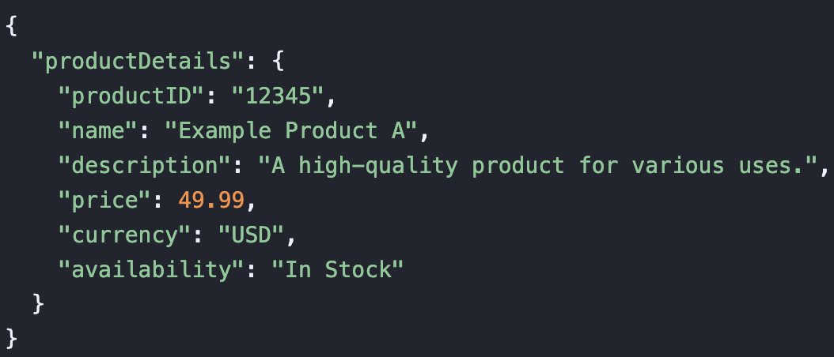
API Type
SOAP API
REST API
GraphQL
gRPC

Slide 5
JSON Data type
JSON Data - A Name and a Value
String, Number, Boolean
Object
Array
{"name":"John", "middlename": null, "age":30, "sale":true }
{ "employee": {"name":"John", "age":30, "city":"New York"} }
{
"employees":[ {"firstName":"John", "lastName":"Doe"}, {"firstName":"Anna", "lastName":"Smith"}, {"firstName":"Peter", "lastName":"Jones"} ]
}

Slide 6
JSOn parser & stringify
const myvar1 = '{"name":"John", "age":30, "car":null}'
const myvar2 = {"name":"John", "age":30, "car":null}
Parser
When receiving data from a web server, the data is always a string.
Parse the data with JSON.parse(), and the data becomes a JSON object.
Stringify
Convert any JSON datatype into a string with JSON.stringify().
Validator

Slide 7
Homework
Show your city current temperature, and tomorrow (or next 3 days) forecast.
National Weather Service API
Canadian weather service

